Slide 1


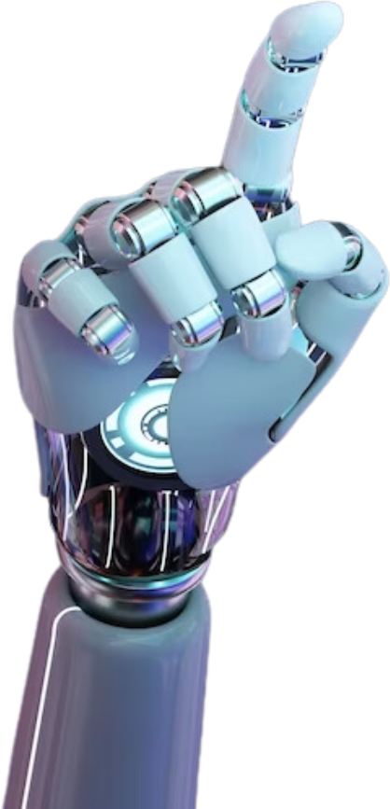
DEEP LEARNING-IMAGE CLASSIFICATION WITH CNN
Group 1
AlHanouf - Randa - Mehdar - Sara

Slide 2

Project Overview
group one
Project Overview
data Analysis
Devlop CNN model from scratch
train per-tran model in same data to comper wi our other model
model deployment

Slide 3


Data Analysis & preprocessing
Data
Analysis
&
preprocessing

Slide 4

Data Analysis
CIFAR-10 dataset, which consists of 60,000 32x32 color images in 10 classes, with 6,000 images per class
class
airplane
automobile
bird
cat
deer
ship
truck
horse
frog
dog

Slide 5
Data Analysis wrangling , cleaning
Data
preprocessing
Download Data
convert
to-one hot encoded
Data
Augmentation
Explor Data
Normaliztion

Slide 6
Devlop CNNmodel from scratch
Devlop CNN model
from scratch

Slide 7
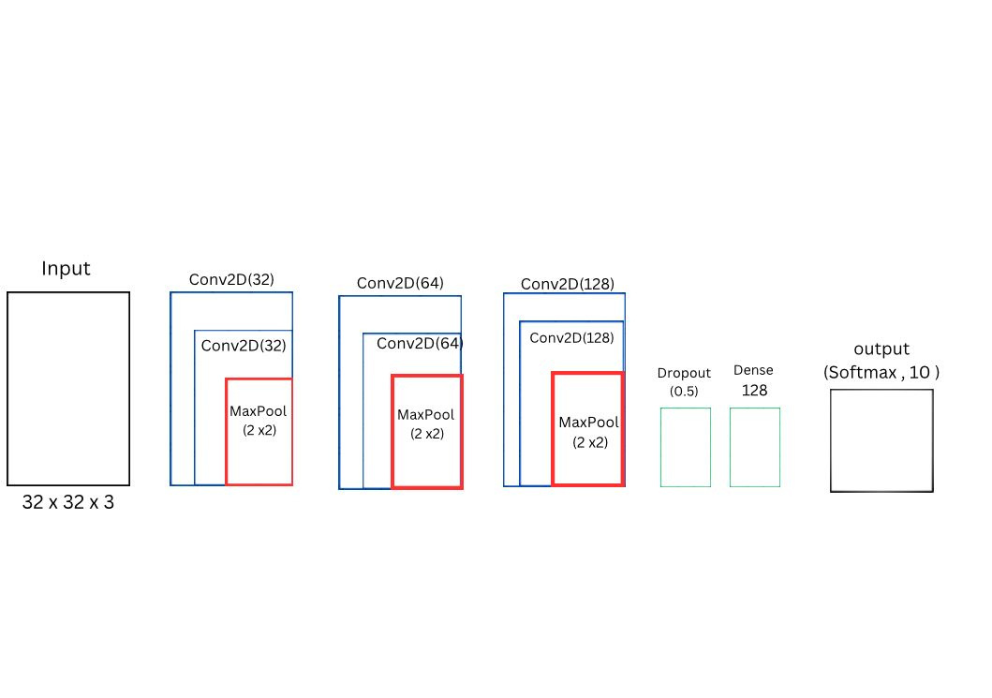
Beas model

Slide 8
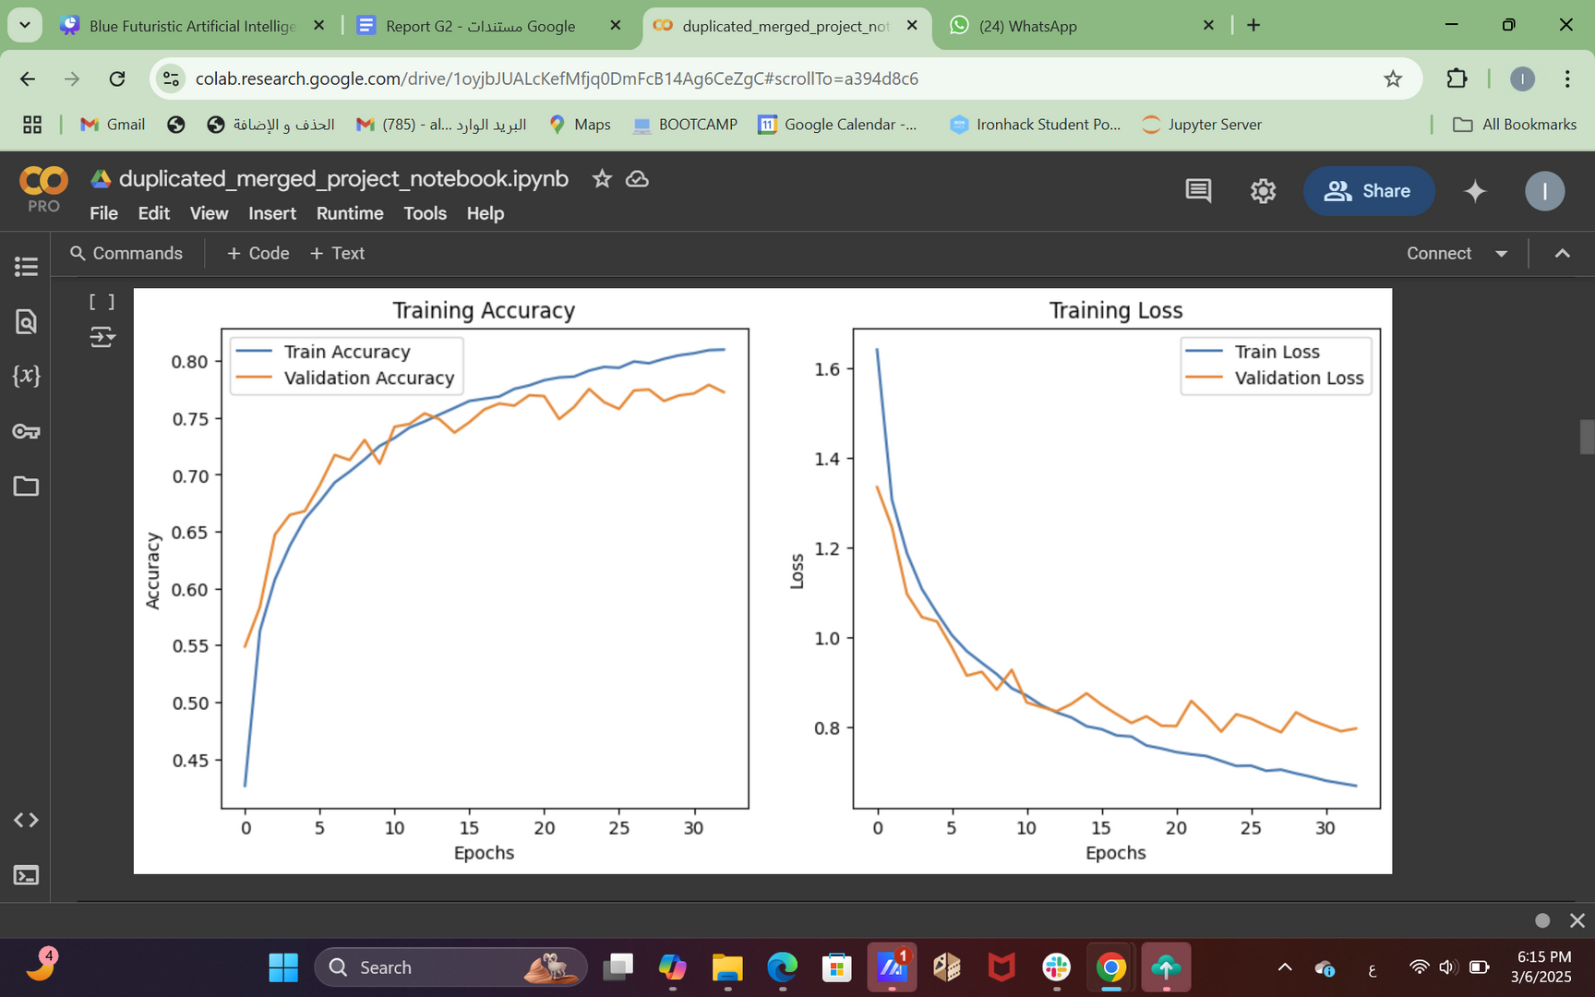
Beas model

Slide 9
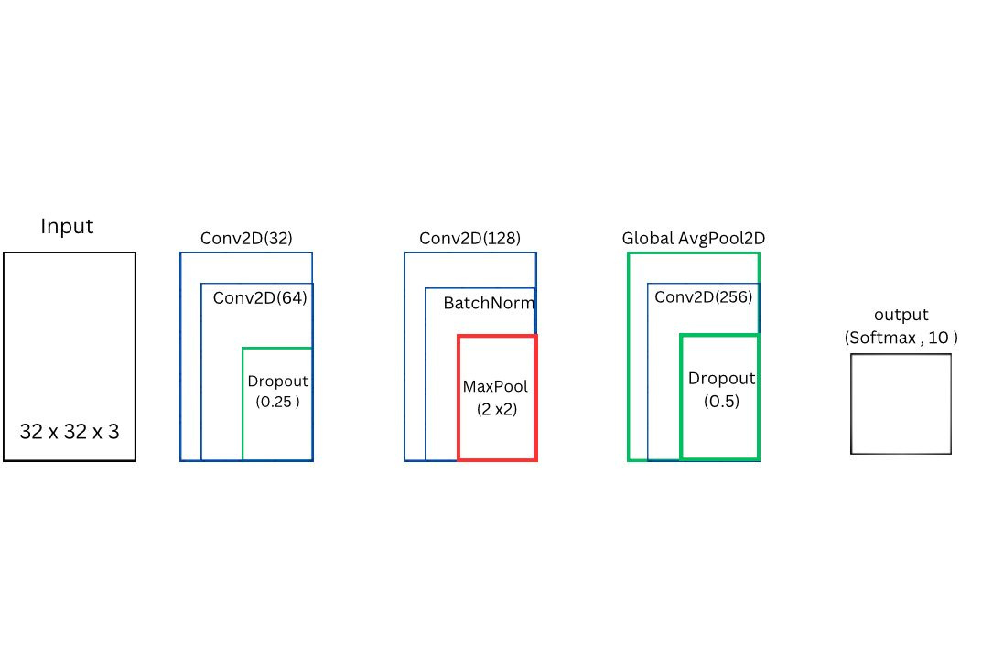
Skip connection

Slide 10
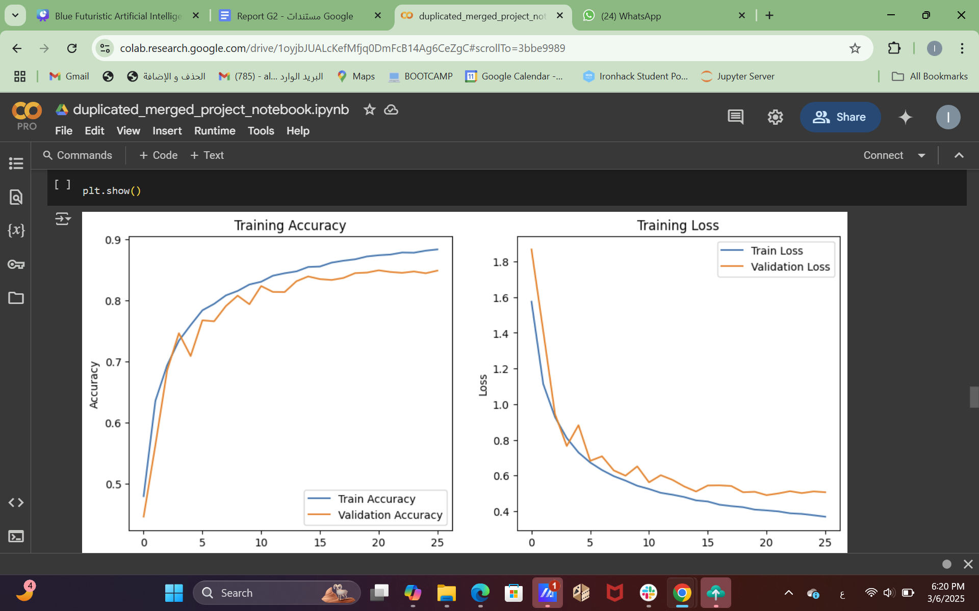
Skip connection

Slide 11
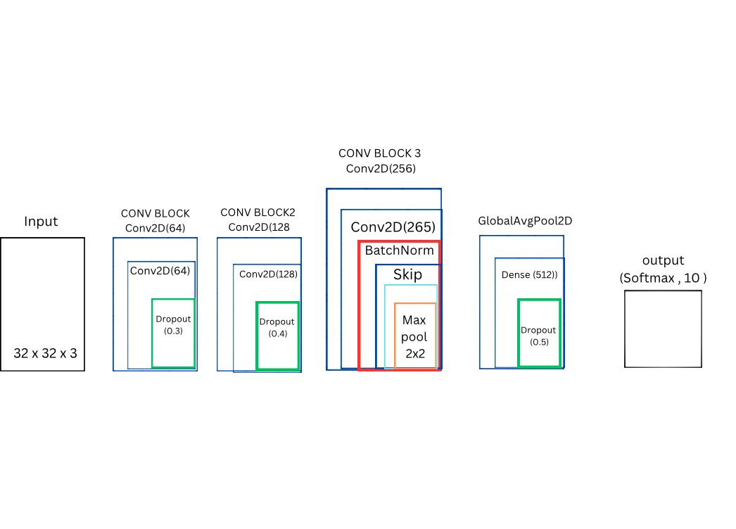
Advance Skip connection

Slide 12
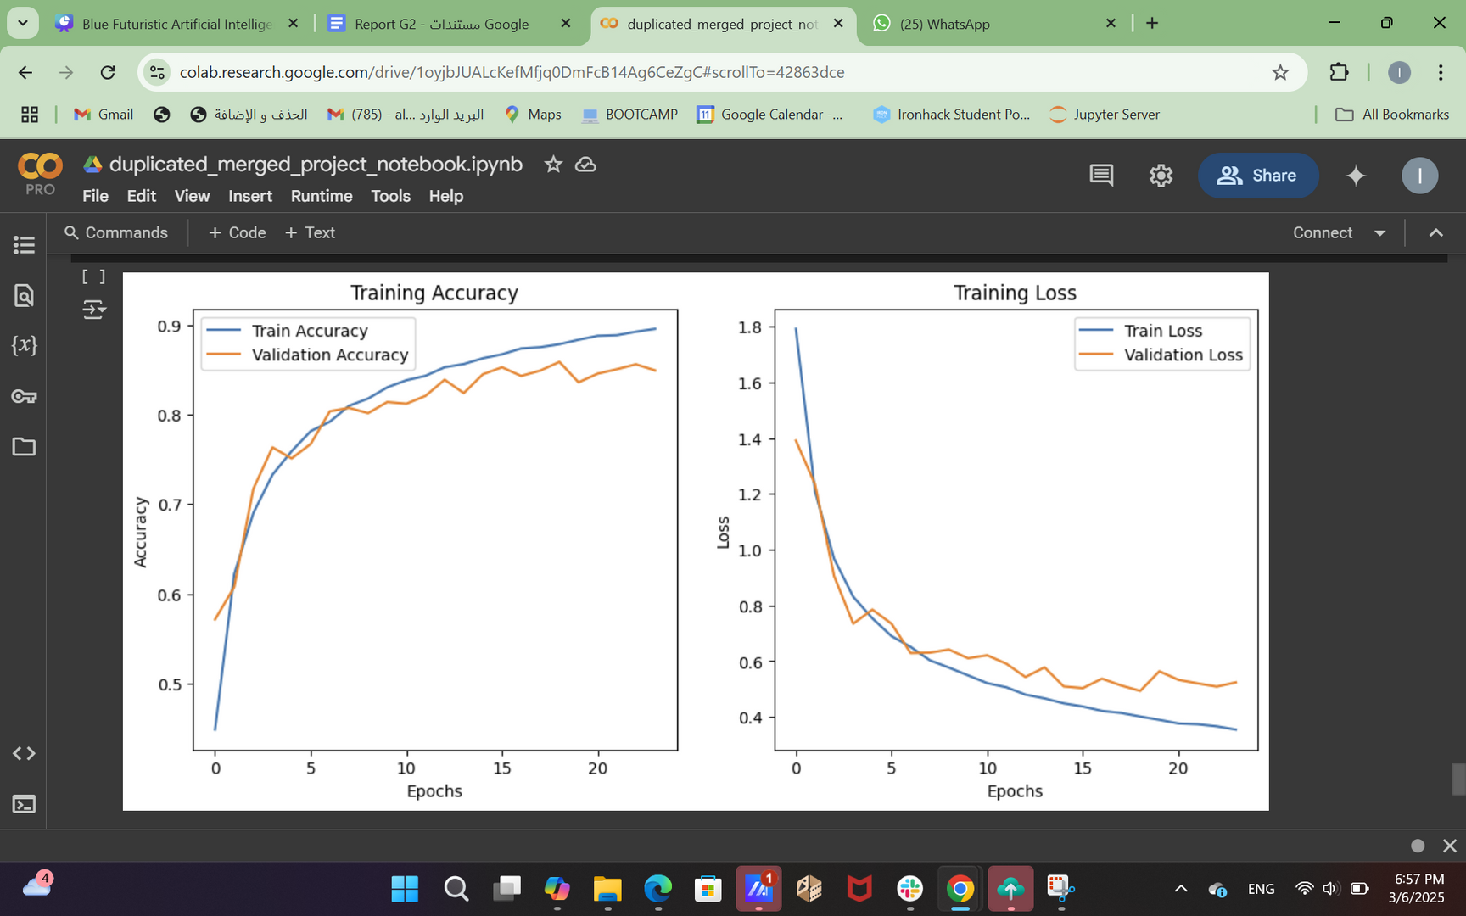
Advance Skip connection

Slide 13
Transfer Learning
Transfer Learning

Slide 14
pre-trained model
Pre-trained Model | Res Net 50 | Efficient Net V2
Metrics | Metrics | Metrics
Train Accuracy | 89.343% | 95.46%
Validation Accuracy | 87.331% | 95.24%
Train Loss | 0.6202 | 0.1408
Validation Loss | 0.7886 | 0.1502
Total Parameters | 4,229,222 | 6,580,314
Best model selection
Efficient Net V2B0
Res Net 50

Slide 15
Observation between Models
Observation
between Models

Slide 16
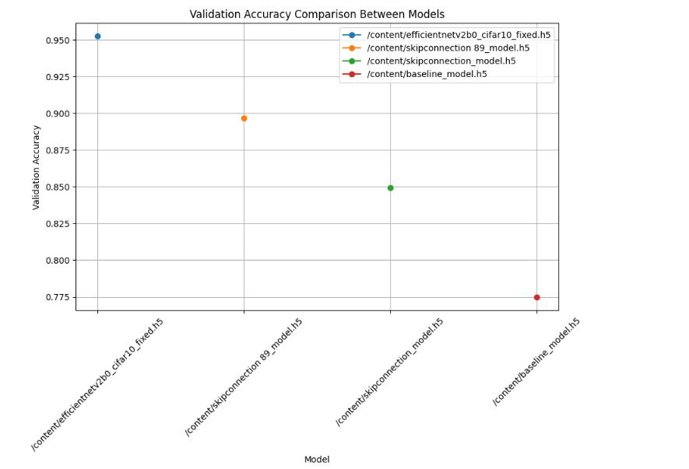
Observation between Models

Slide 17
Model deployment
Model
deployment

Slide 18
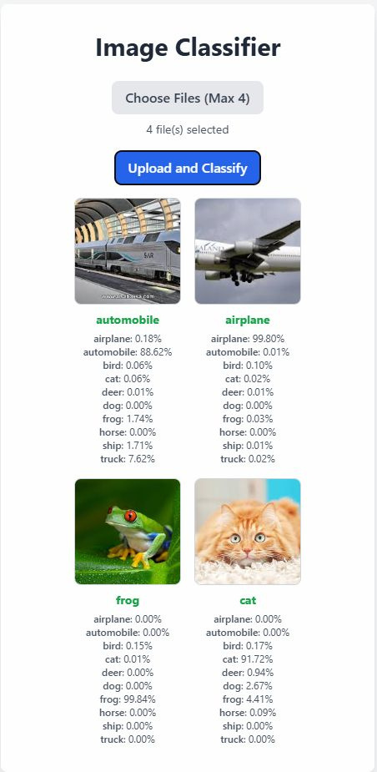
Model
deployment :

Slide 19


Major Obstacle
Major Obstacle
1 - Data Size
2- Computational power (GPUs/TPUs)

Slide 20
PROJECT 2
THANK YOU !
GROUP ONE 1
AlHanouf - Randa - Mehdar - Sara

